Slide 1
3D Gravity Inversion of a Synthetic Geological Model in SimPEG
How do inversion method and weighting strategy affect recovery of subsurface density structure?

Slide 2
Setup / Motivation
gravity data only indirectly reflects subsurface density
inversion is non-unique
regularization choices can change recovered geometry
synthetic test lets us compare recovered model against known truth

Slide 3
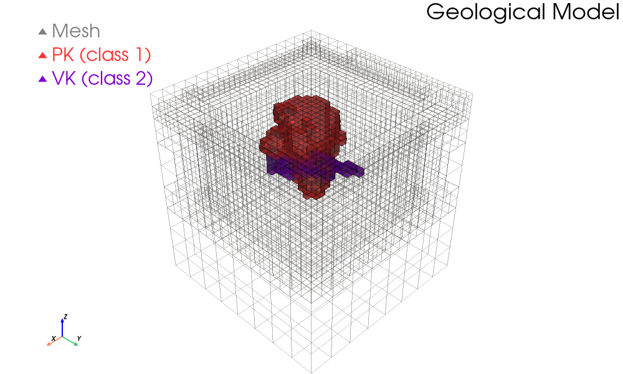
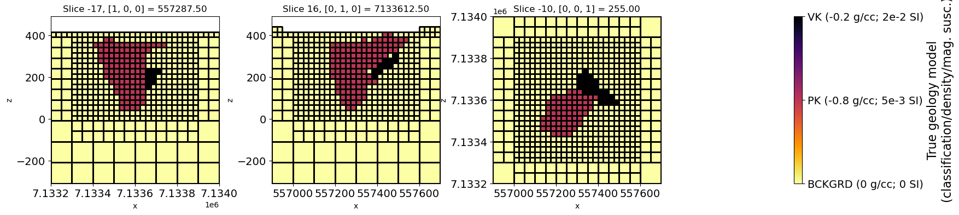
Physical properties
Density: background 0, PK = -0.8, VK = -0.2
two anomalous bodies embedded in zero-density background

Slide 4
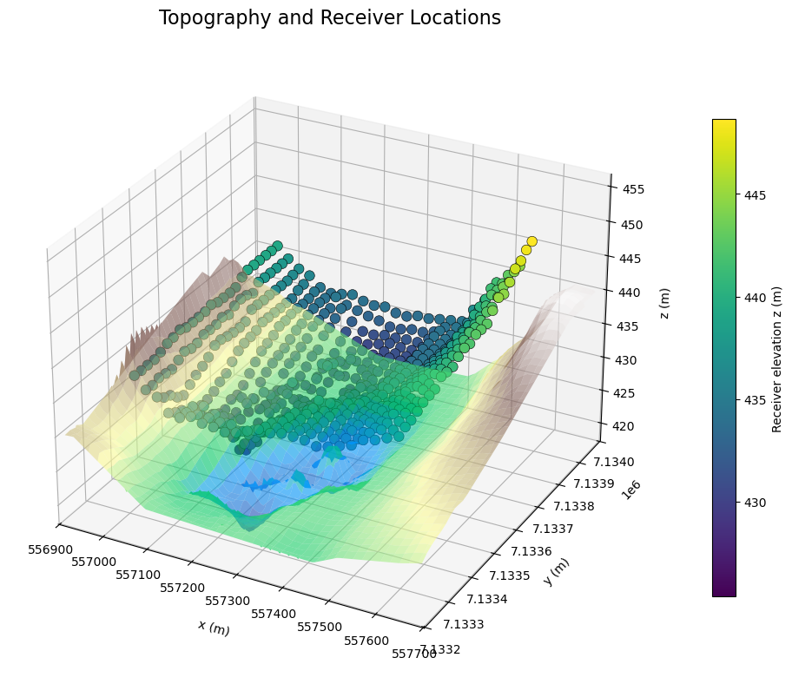
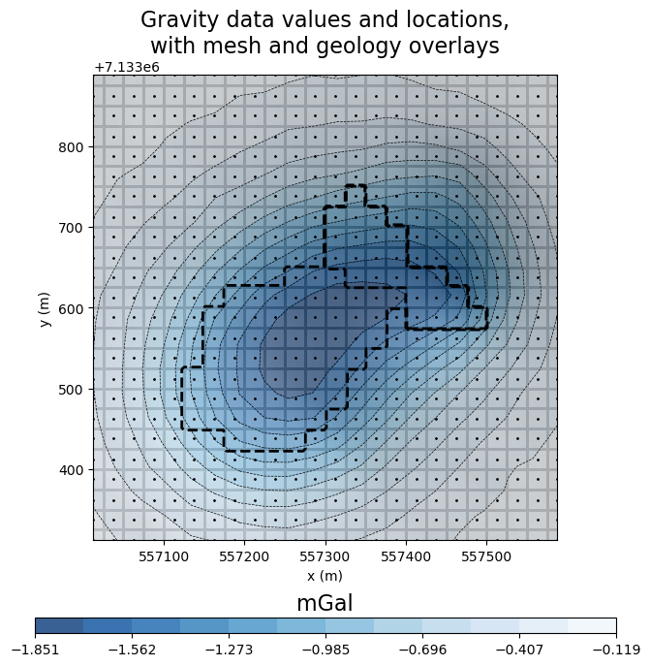
Survey + data

Slide 5
Inversion
Least-square L2
Iteratively Re-weighted Least-Squares (IRLS)
Depth-weighted IRLS
Sensitivity-weighted IRLS
Reweighted-data IRLS

Slide 7
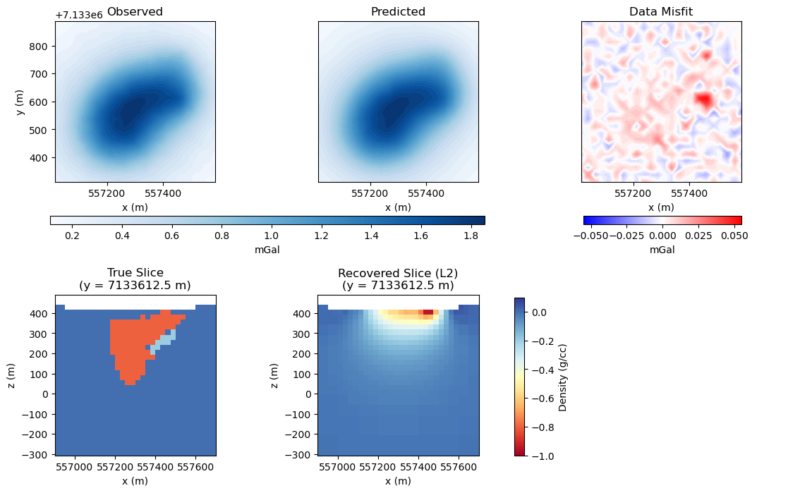
Inversion
Least-square L2

Slide 8
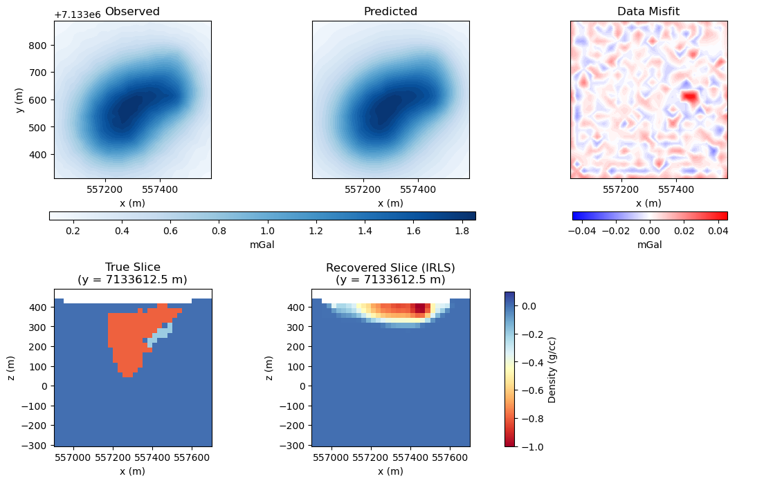
Inversion
Iteratively Re-weighted Least-Squares (IRLS)

Slide 9
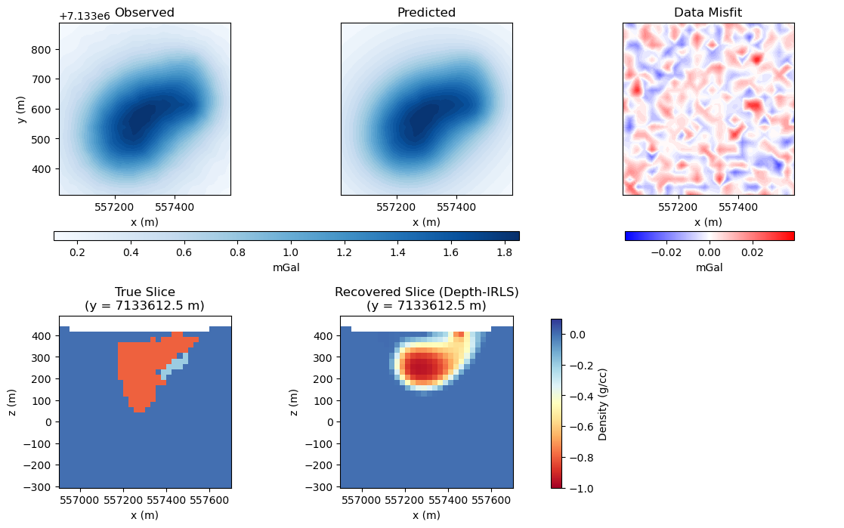
Inversion
Depth-weighted IRLS
Iteratively Re-weighted Last-Squares (IRLS)

Slide 10

Inversion
Sensitivity-weighted IRLS

Slide 11
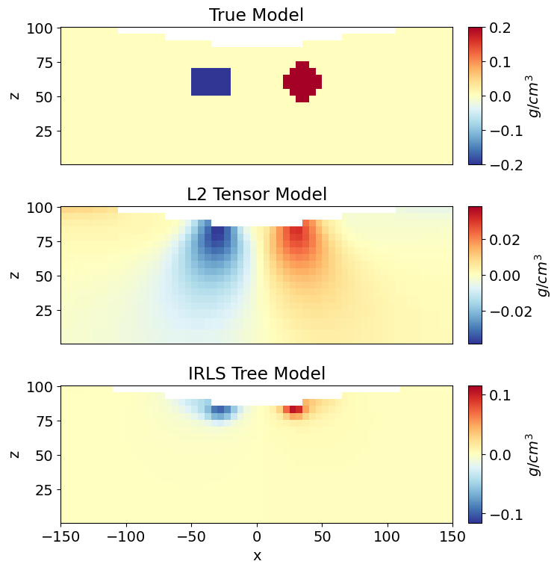
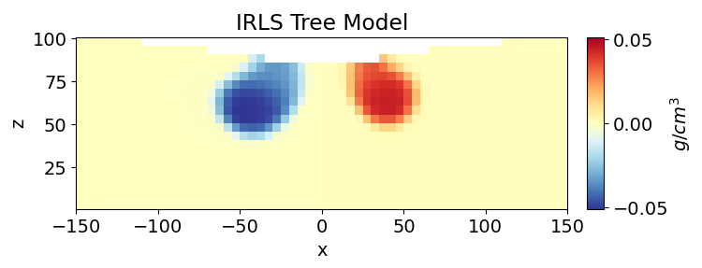
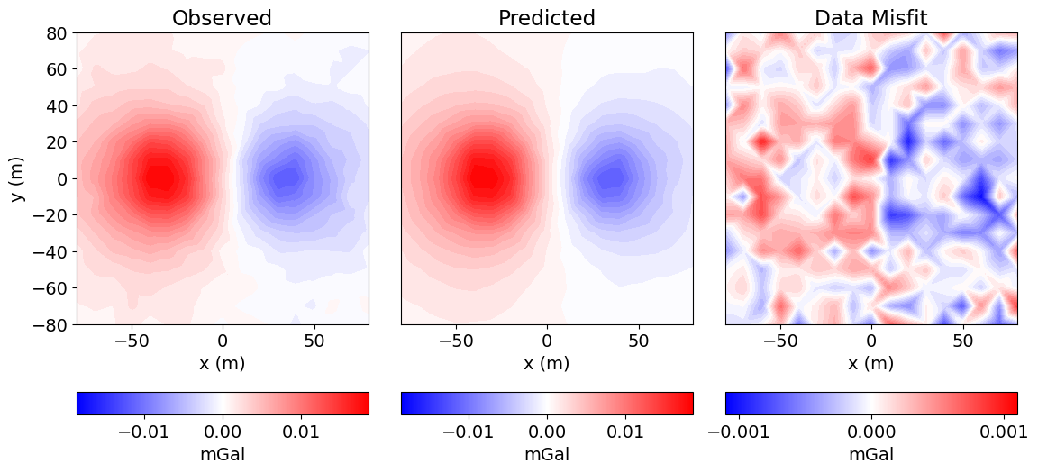
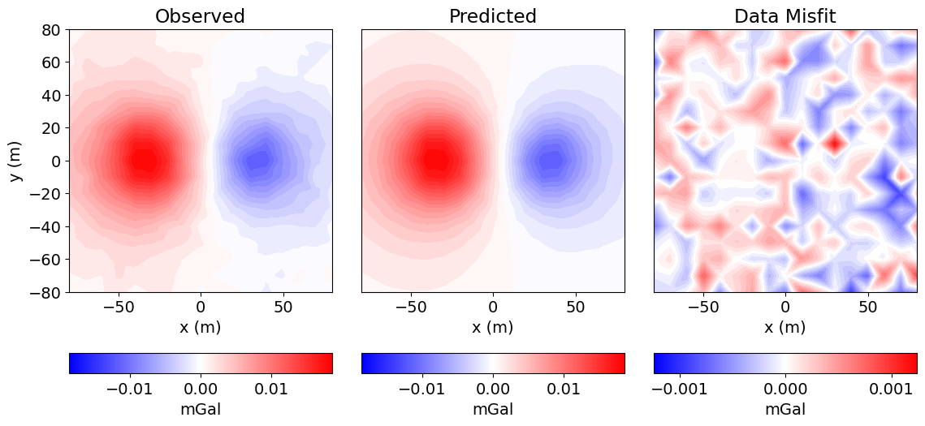
Sensitivity Weighting

Slide 12
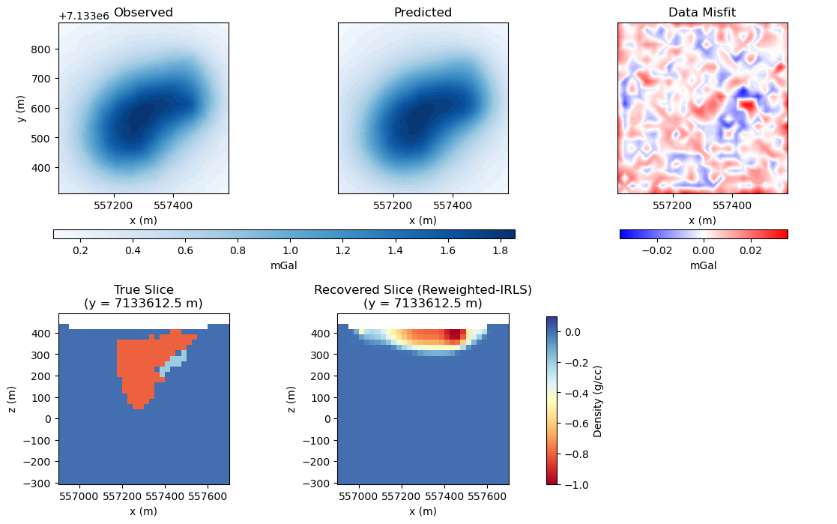
Inversion
Reweighted-data IRLS

Slide 13
